Slide 1
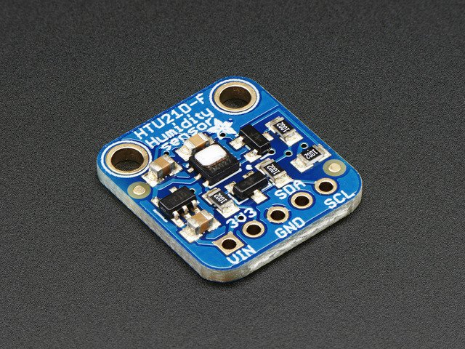
HTU21D-F Humidity/Temperature Sensor
By Johnson Dinh

Slide 2
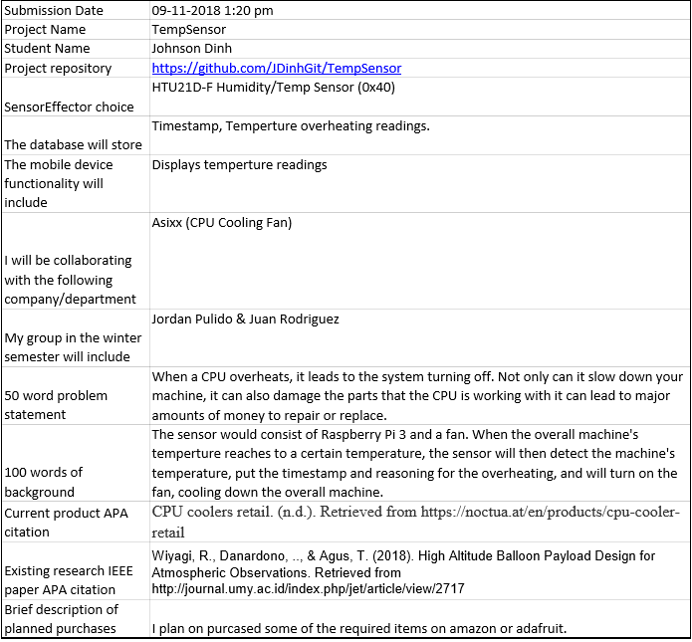
Proposal

Slide 3
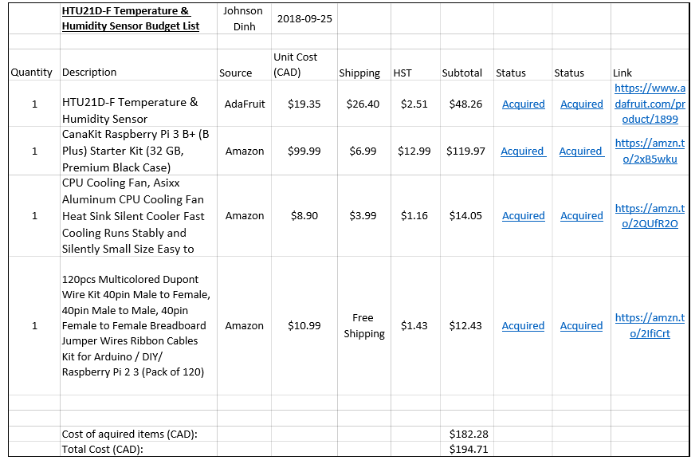
Budget Plan (Old)

Slide 4
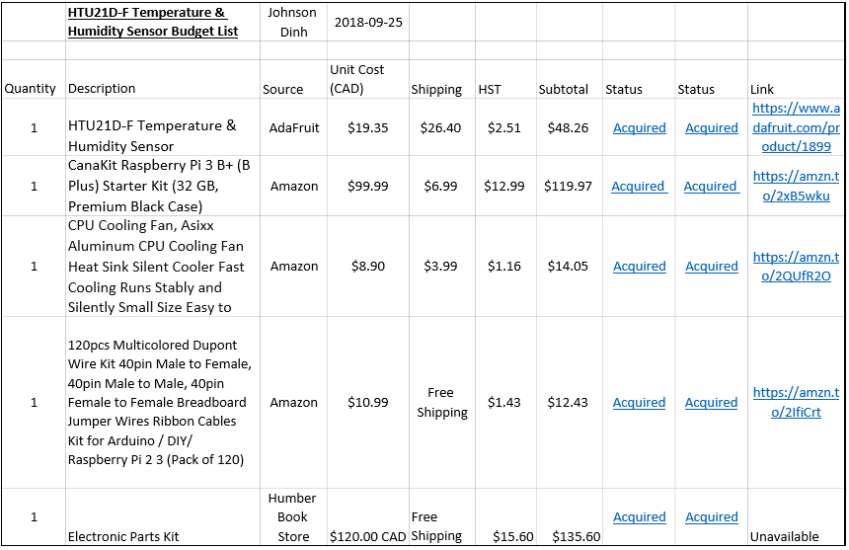
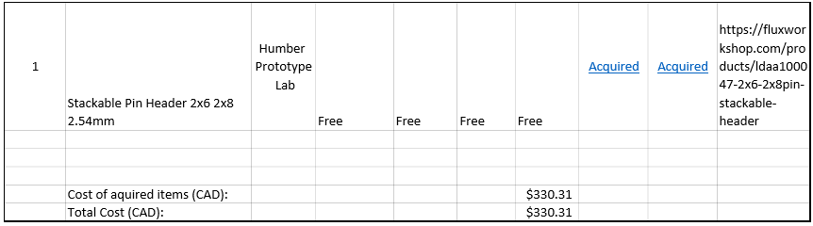
Budget Plan (Updated)

Slide 5
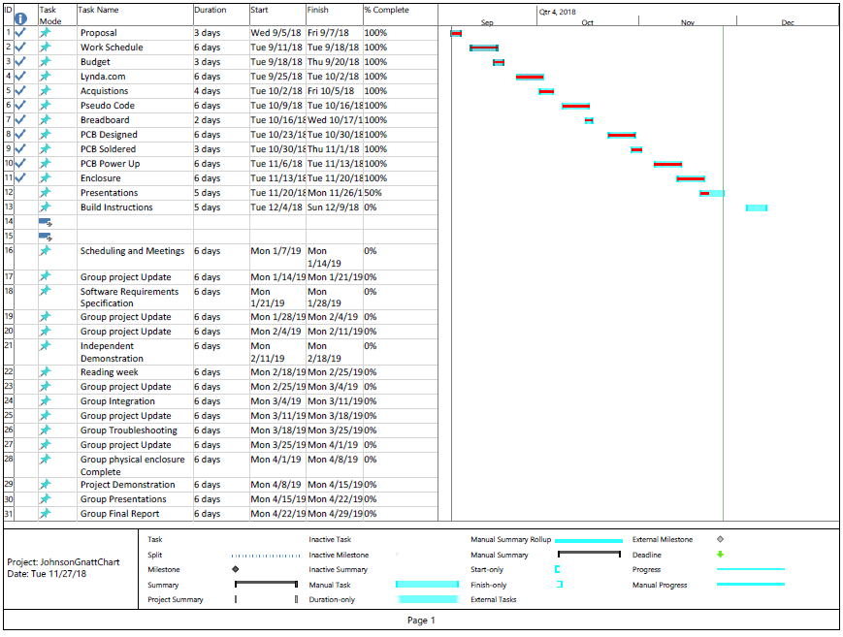
Schedule

Slide 6
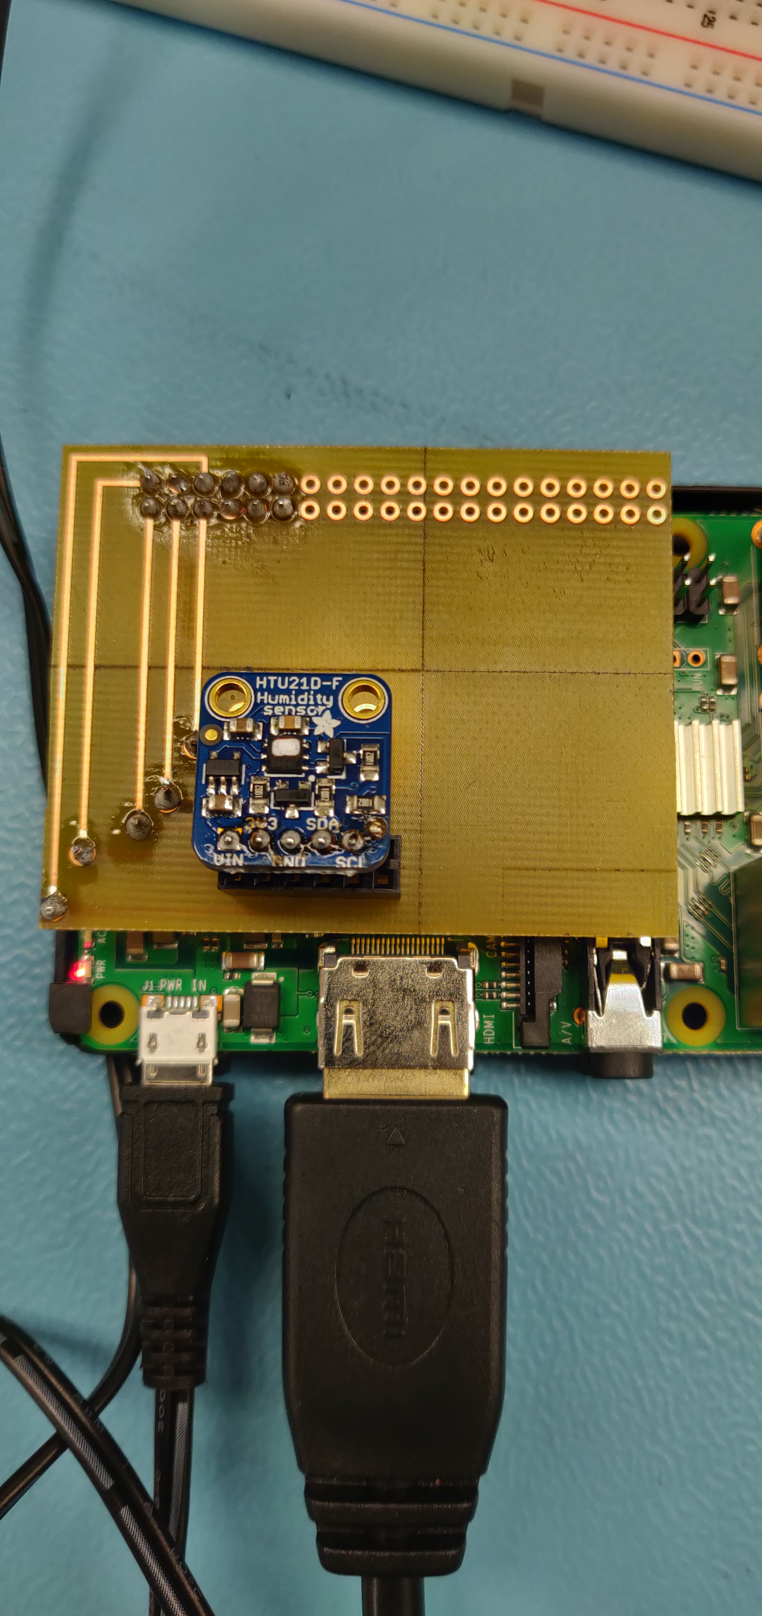
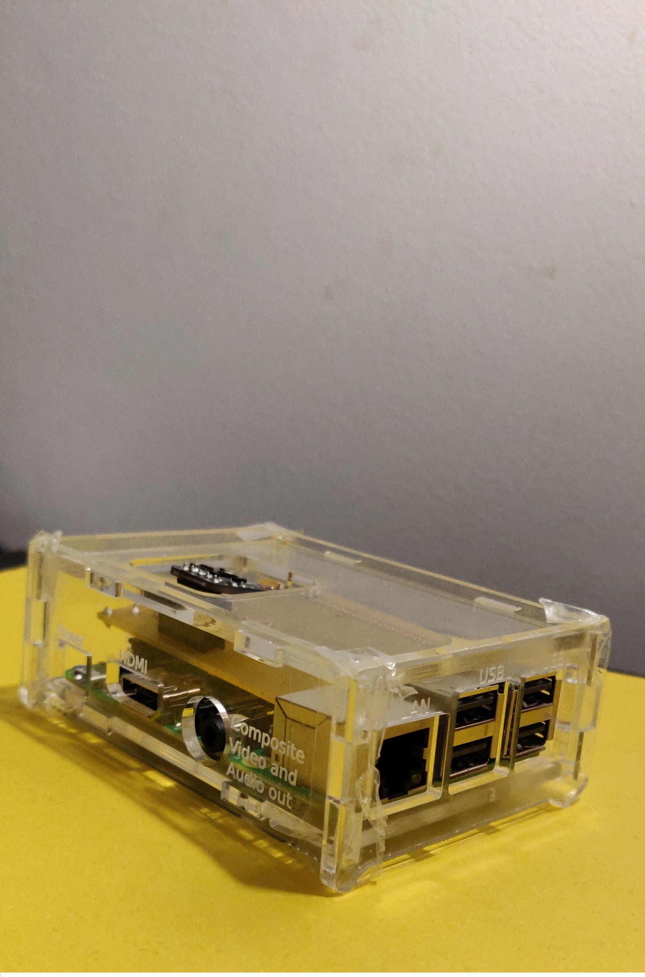
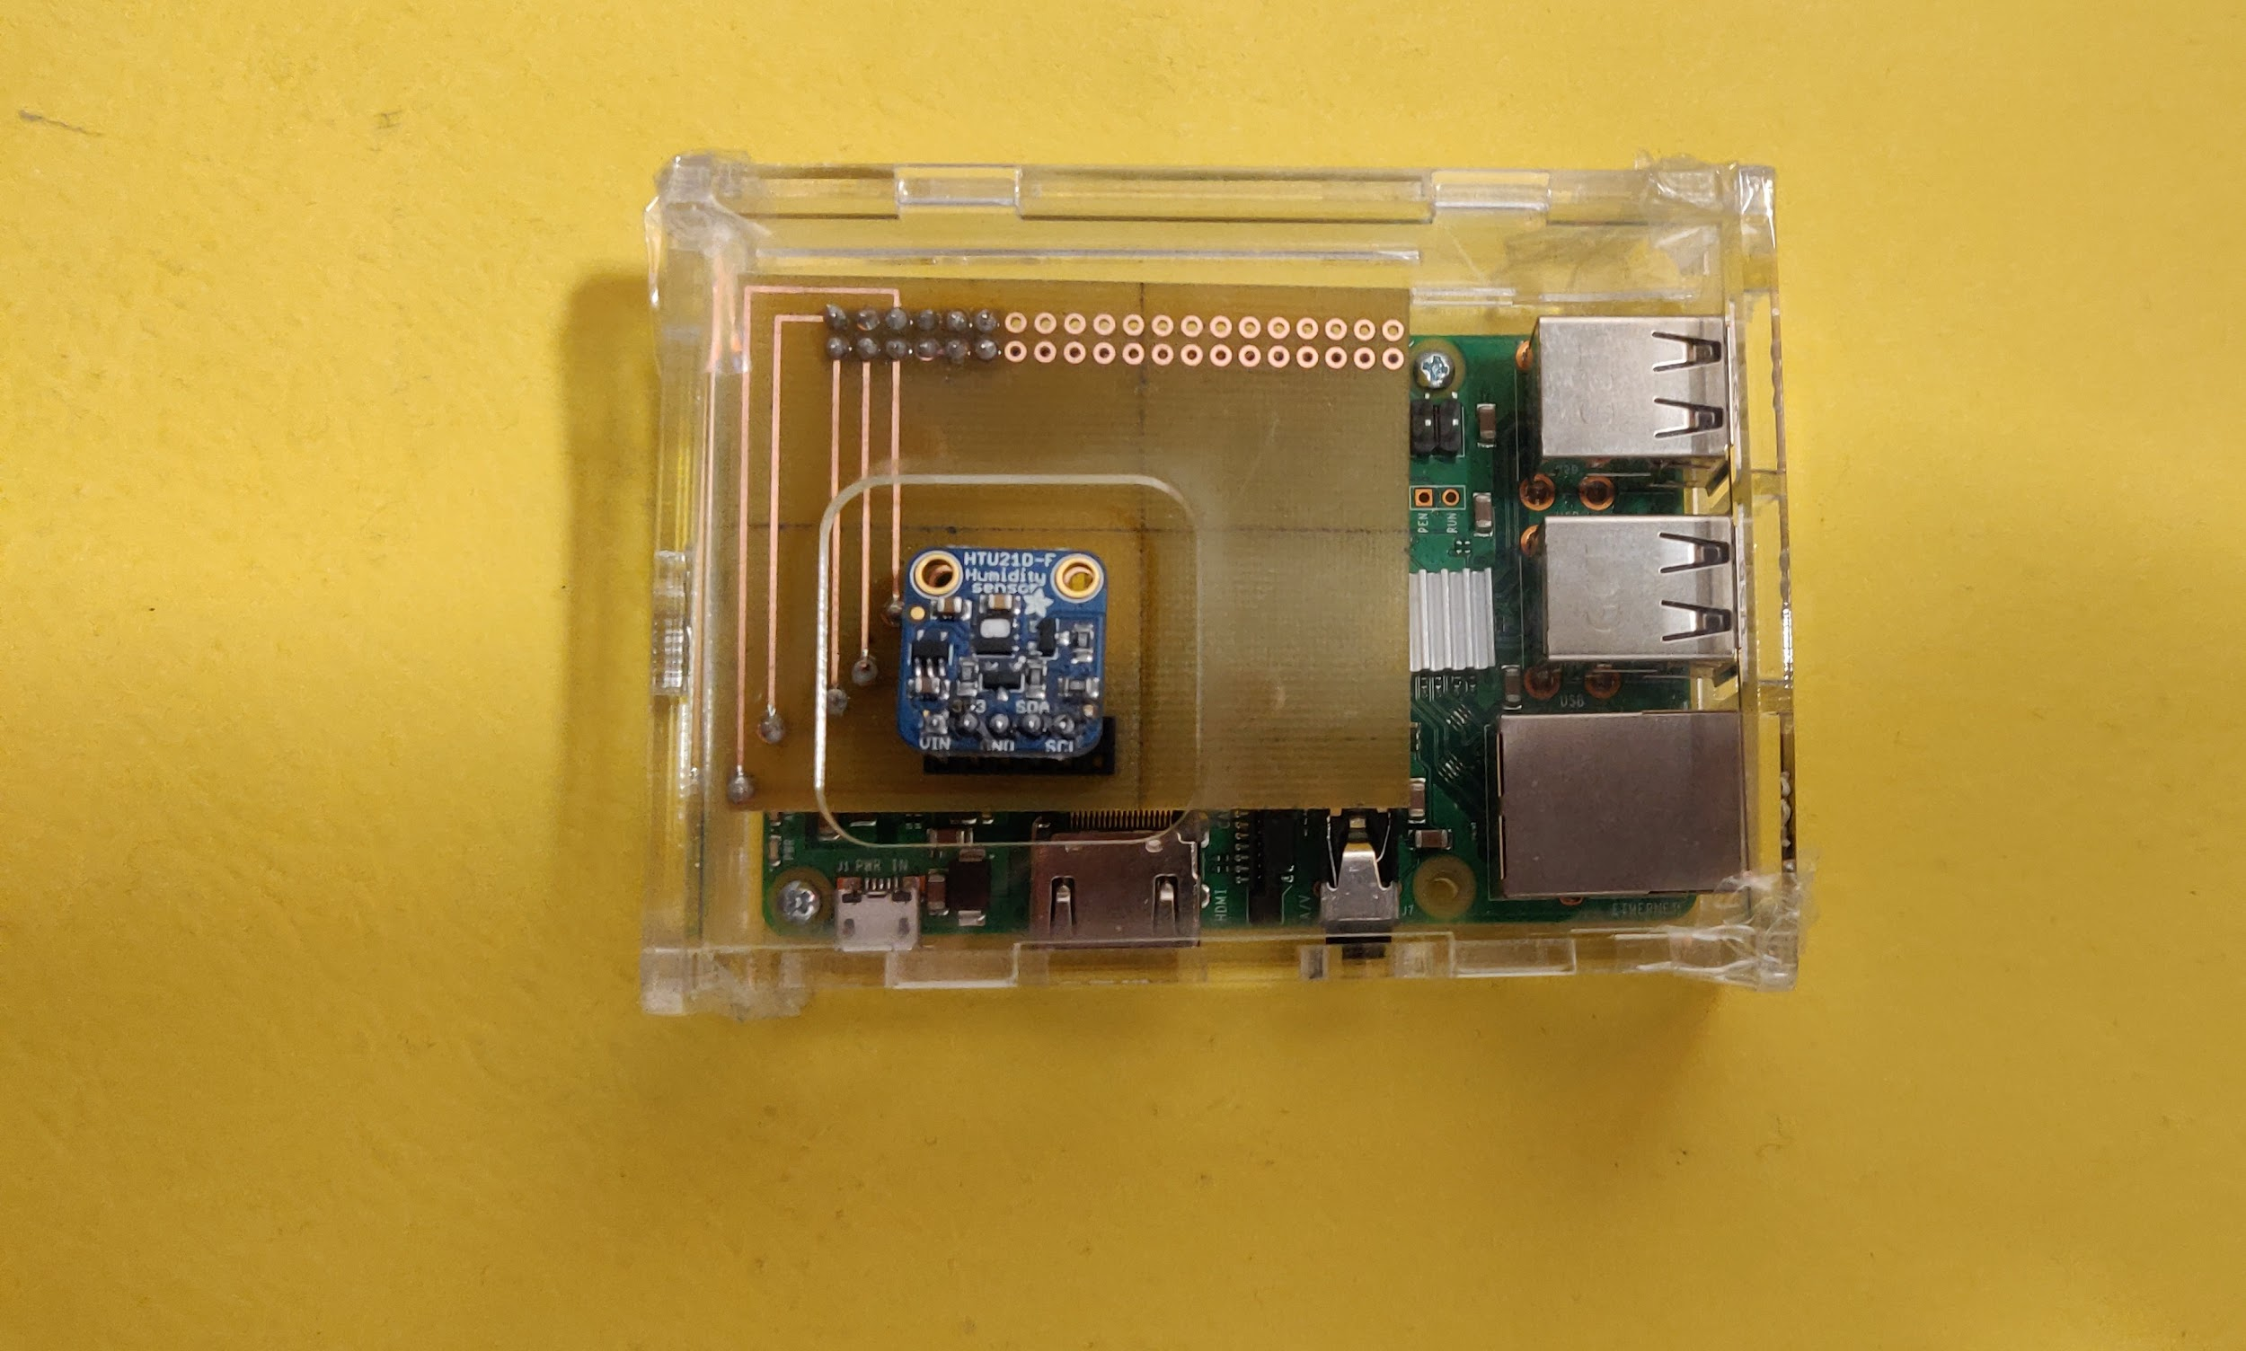
Enclosed Hardware

Slide 7
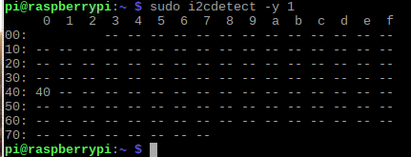
Outputs
Address (0x40)

Slide 8
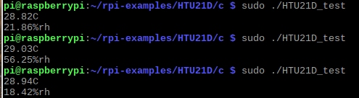
Output

Slide 9
References
https://github.com/leon-anavi/rpi-examples/tree/master/HTU21D/c

Slide 10
Course Knowledge
CENG 216: Intro to Software Engineering
Gnatt Chart
Budget Plan
CENG 252: Embedded Systems
Ability to read and write sensors to the raspberry pi
Writ 220: Technical Workplace Writing Skills
Proposal

